Slide 1

Viva Presentation
Procedural Generation of Realistically Scaled Planets
Adam Hurst

Slide 2
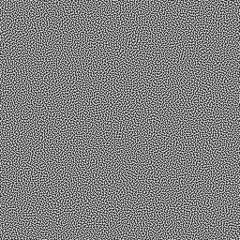
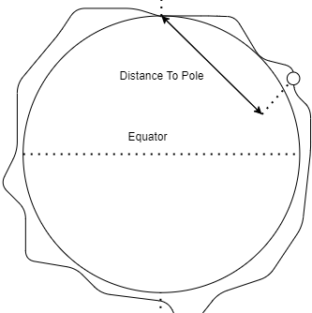
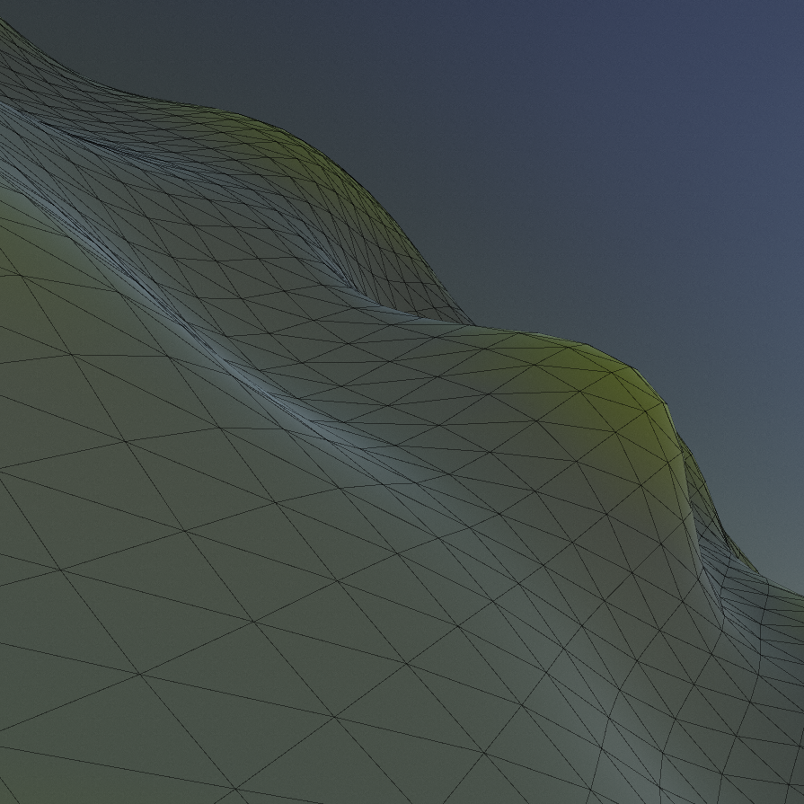
Topics
Context
Research
Design
Product Demonstration
Evaluation
Conclusion

Slide 3

Context

Slide 4
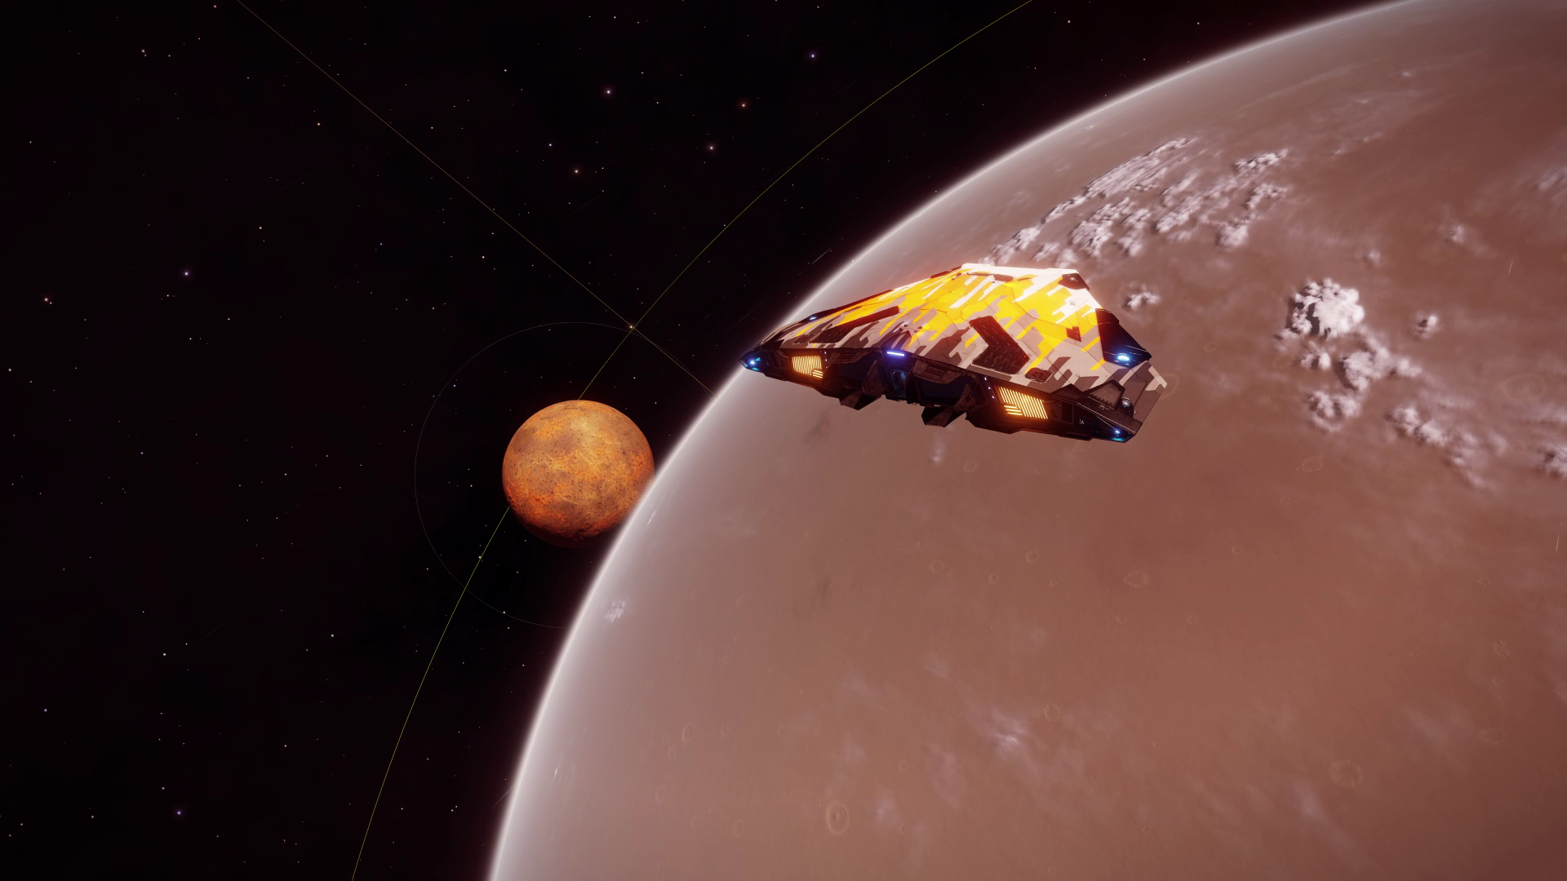
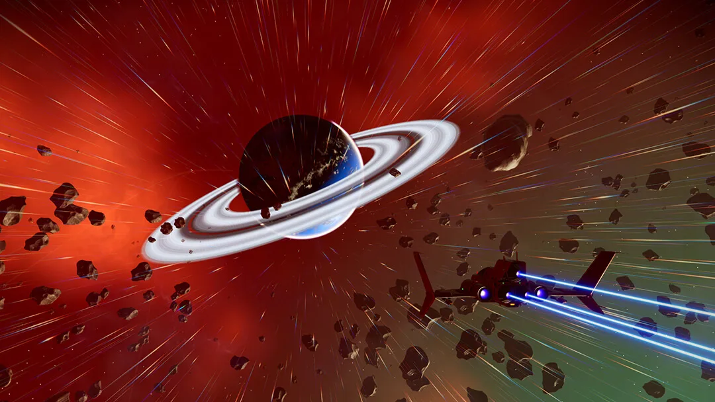
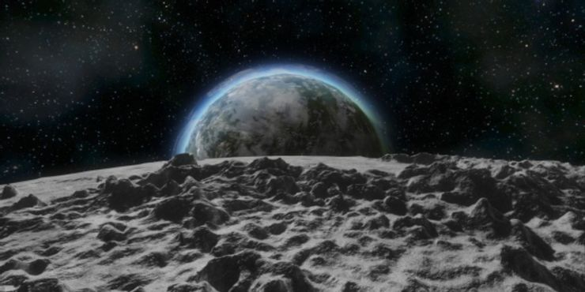

Slide 5
Goals of Project
Create realistically sized planets
Diverse
Seamless gameplay experience
Outputs
Unity Game
Unity Package

Slide 6
Research

Slide 7
Sphere Generation
Terrain Generation
Level of Detail
Atmospheric Rendering
Floating Point Precision
Main areas of Research

Slide 8
Design

Slide 9
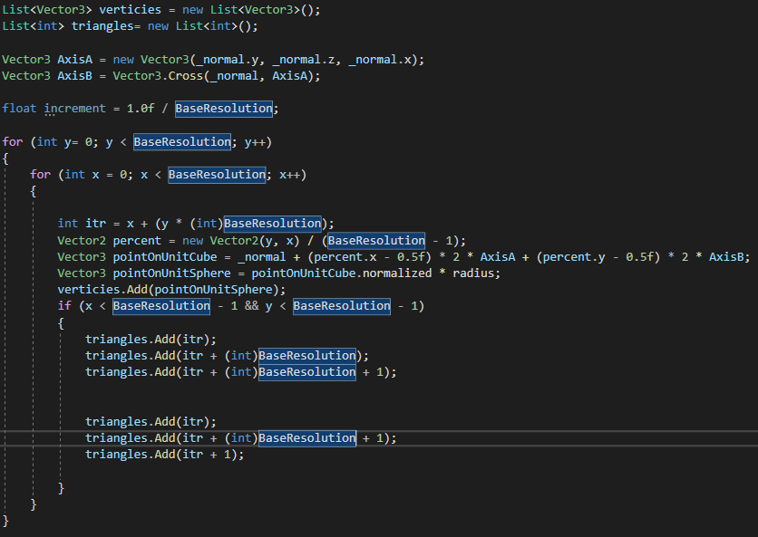

Slide 10
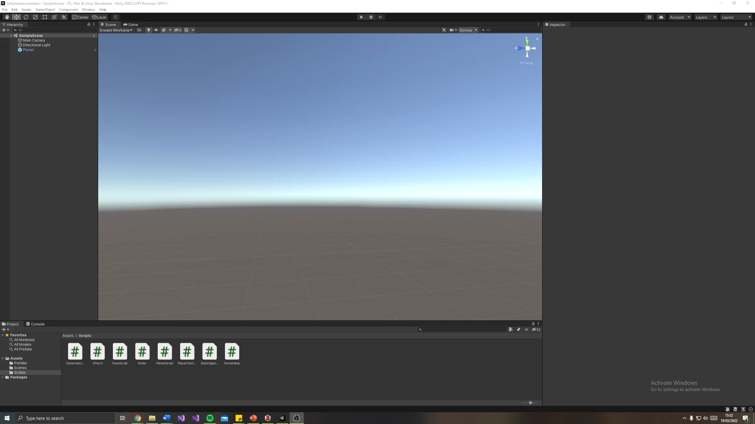

Slide 11
Plan to Continue

Slide 12
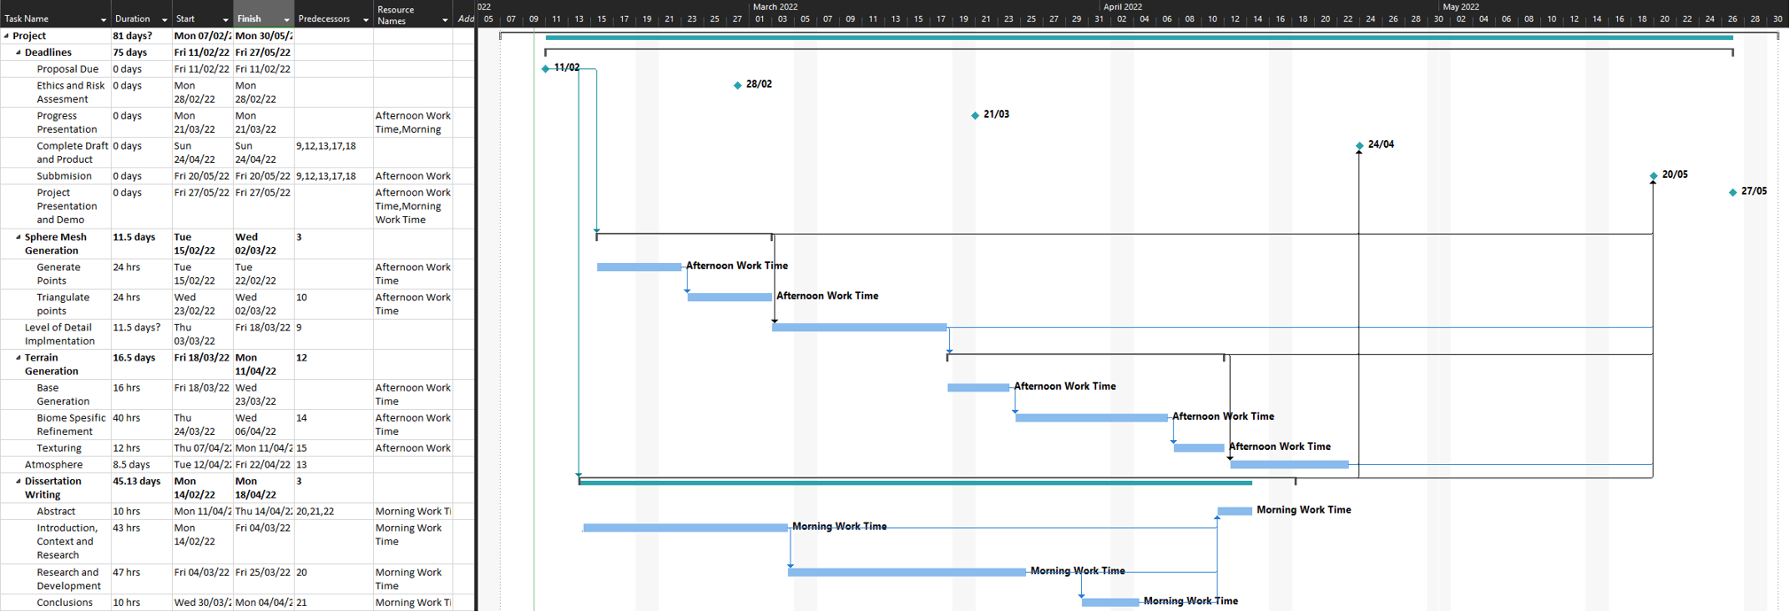
Plan

Slide 13
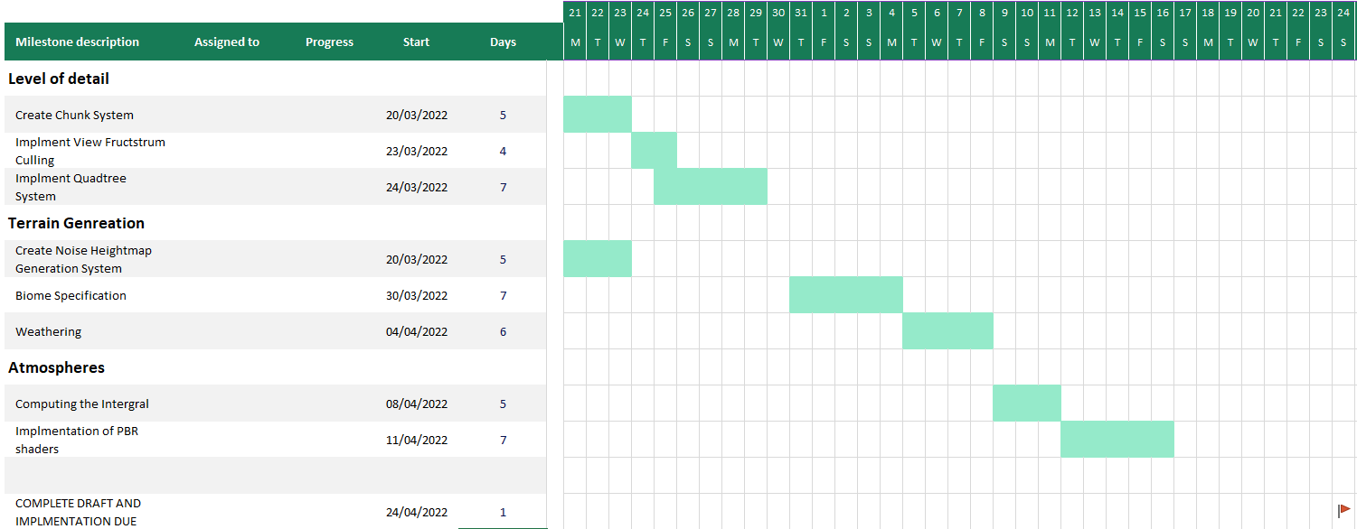

Slide 14
References
Ackroyd, L., 2021. Space Engineers: Everything You Need To Know About Planets [online]. TheGamer. Available from: https://www.thegamer.com/space-engineers-everything-need-know-planets/ [Accessed 20 Mar 2022].
Anon., 2022a. no-mans-sky-next1.jpg (1080×608) [online]. Available from: https://bgr.com/wp-content/uploads/2018/07/no-mans-sky-next1.jpg?quality=82&strip=all [Accessed 20 Mar 2022].
Anon., 2022b. jMonkeyEngine Docs [online]. Available from: https://wiki.jmonkeyengine.org/docs/3.4/core/terrain/terrain.html [Accessed 20 Mar 2022].
Building Worlds in No Man’s Sky Using Math(s), 2017. Available from: https://www.youtube.com/watch?v=C9RyEiEzMiU [Accessed 19 Mar 2022].
Cajaraville, O. S., 2019. Four Ways to Create a Mesh for a Sphere. Medium [online]. Available from: https://medium.com/@oscarsc/four-ways-to-create-a-mesh-for-a-sphere-d7956b825db4 [Accessed 2 Feb 2022].
Christio02, 2021. Will we be able to land on planets like this in Odyssey? r/EliteDangerous [online]. Available from: www.reddit.com/r/EliteDangerous/comments/mkl48g/will_we_be_able_to_land_on_planets_like_this_in/ [Accessed 20 Mar 2022].
Elek, O., 2009. Rendering Parametrizable Planetary Atmospheres with Multiple Scattering in Real-Time, 8.
Fischer, R., Dittmann, P., Weller, R. and Zachmann, G., 2020. AutoBiomes: procedural generation of multi-biome landscapes. The Visual Computer, 36 (10–12), 2263–2272.
Keinert, B., Innmann, M., Sänger, M. and Stamminger, M., 2015. Spherical fibonacci mapping. ACM Transactions on Graphics, 34 (6), 1–7.
O’Neil, 2022. A Real-Time Procedural Universe, Part Three: Matters of Scale [online]. Available from: https://www.gamasutra.com/view/feature/131393/a_realtime_procedural_universe_.php [Accessed 4 Feb 2022].
Patel, A., 2022. Delaunay+Voronoi on a sphere [online]. Available from: https://www.redblobgames.com/x/1842-delaunay-voronoi-sphere/ [Accessed 4 Feb 2022].
Schafhitzel, T., Falk, M. and Ertl, T., 2007. Real-Time Rendering of Planets with Atmospheres, 8.
Sin, Z. P. T. and Ng, P. H. F., 2018. Planetary Marching Cubes: A Marching Cubes Algorithm for Spherical Space. In: Proceedings of the 2018 the 2nd International Conference on Video and Image Processing [online]. Presented at the ICVIP 2018: 2018 the 2nd International Conference on Video and Image Processing, Hong Kong Hong Kong: ACM, 89–94. Available from: https://dl.acm.org/doi/10.1145/3301506.3301522 [Accessed 21 Feb 2022].
Unite 2013 - Building a new universe in Kerbal Space Program, 2013. Available from: https://www.youtube.com/watch?v=mXTxQko-JH0 [Accessed 10 Feb 2022].

